Slide 1

A Training Report On ONLINE RAJASTHAN TOURISM Submitted by Arju Bano & Shikha Tiwari
Banasthali Vidyapith (Raj.) &
Compucom Engineering College(Raj.)
Training Incharge
Mr. Lalit Matoliya
C-DAC ATC NETCOM
Internal Guide
Mr. Deependra Kumar

Slide 2
Table Of Contents
PROJECT OVERVIEW
PROBLEM OF STATEMENTS
OBJECTIVES
SPECIFIC REQUIREMENTS
FLOW DIAGRAM
USER INTERFACE SCREENS
CONCLUSION

Slide 3
Introduction of Project
India one of the most beautiful locations of Rajasthan is also among the popular state of the world.
Tourist hub welcomes more than a 5 thousands tourists from different locations of India.
A trip to this beautiful state can reveal numerous mystic things regarding its culture, art, tradition, history etc.
Tourists are more attracted towards the cultural of this state from Jaipur to Mount Abu. Each tradition symbolizes the flavour of the place.
Rajasthan, a state with numerous scenic sports, Majestic forts is a tourist hub as well.

Slide 4
Problem Statement
The Purpose of website is established fact that Internet users are increasing today. One of the main purpose of the website is to facilitate the offline customer online because customers can not spend their precious time in markets trying to find out the best deal.
India is a country where in a few days holiday, you can enjoy a lot. The problem is that we although having many websites but they offer different kind of services. The customers are enjoying alot but there is a lack of relationship between travel agency and customers and hence we are establishing that relationship by caring and serving all the customers in the same manner that we wished to be served.
We will be putting an effort to provide the right choice to the people when they plan a holiday and beware them from the false advertising.
Our priority will be our customers and their travel requirements.

Slide 5
SPECIFIC REQUIREMENTS
HARDWARE REQUIREMENTS
SOFTWARE REQUIREMENTS
At Developer End
Processor: Intel (R) or More
RAM: 4 GB or More
Storage Capacity: 100 GB or More
At End User
Processor: simple android 4.4+ mobile phone, pc and ios with wifi access
RAM: 256 MB or More
Front-end: HTML, CSS, Javascript, Bootstrap
Back-end: Python, dbsqlite, JQUERY
Framework: Django
OS: Window 7 or above

Slide 6
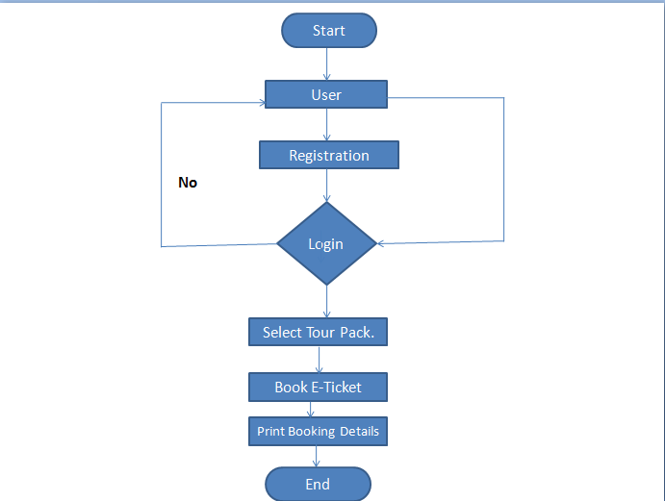
Flow Diagram

Slide 7
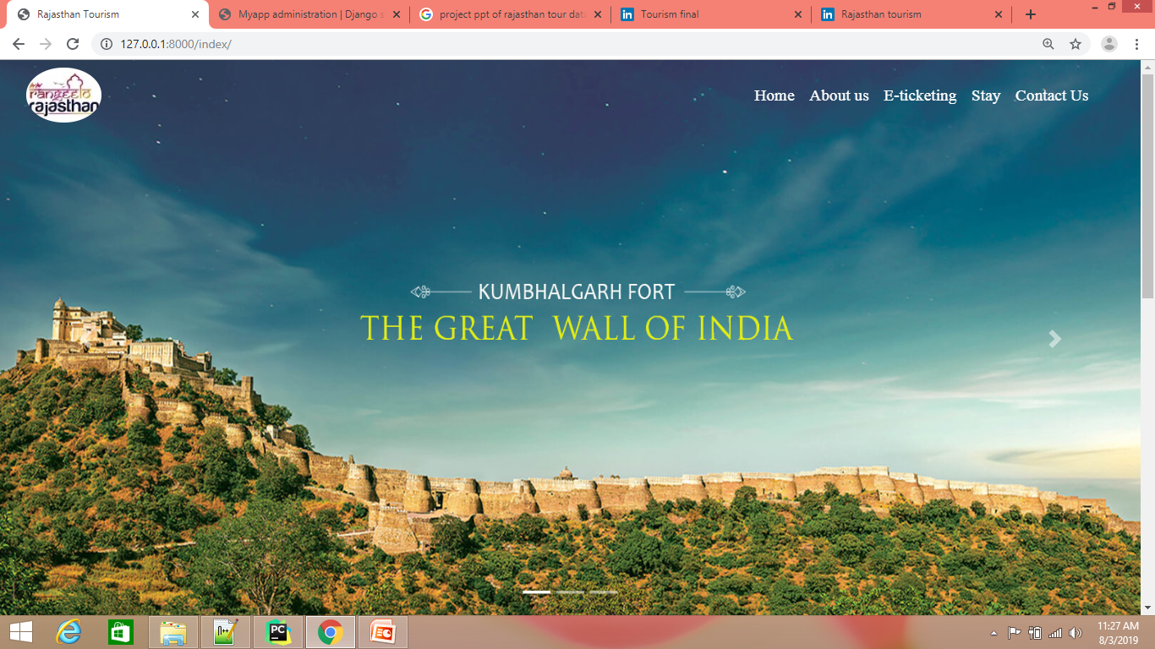
Index

Slide 8
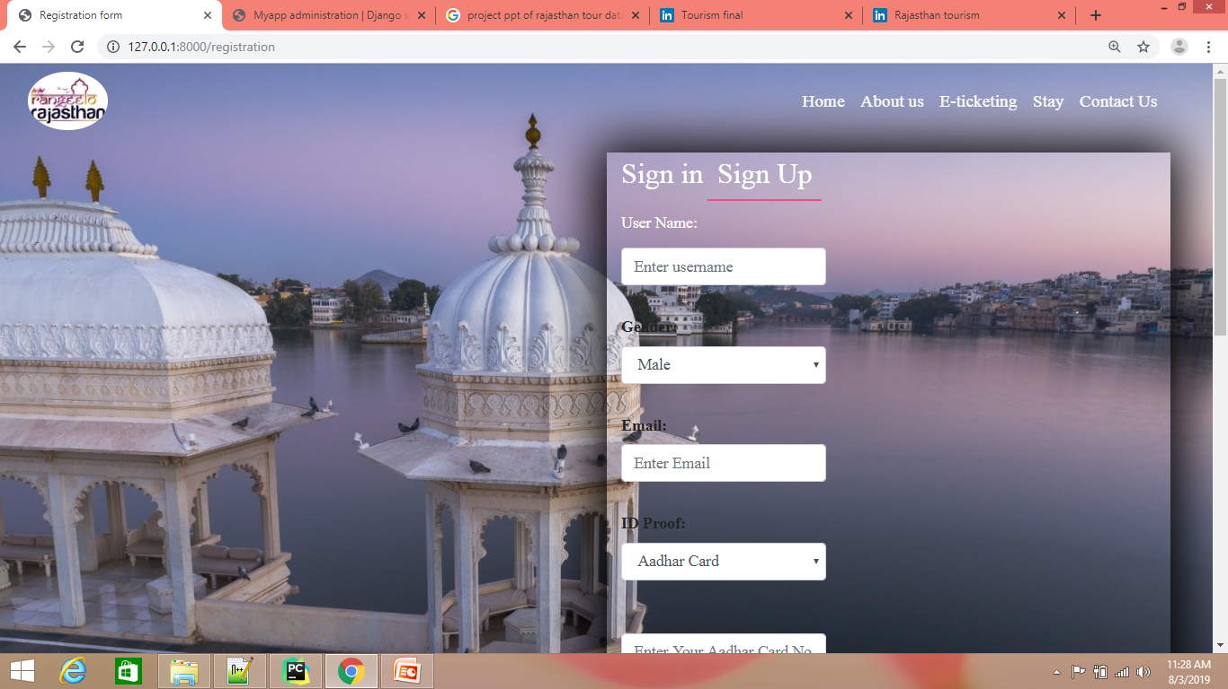
Registration

Slide 9
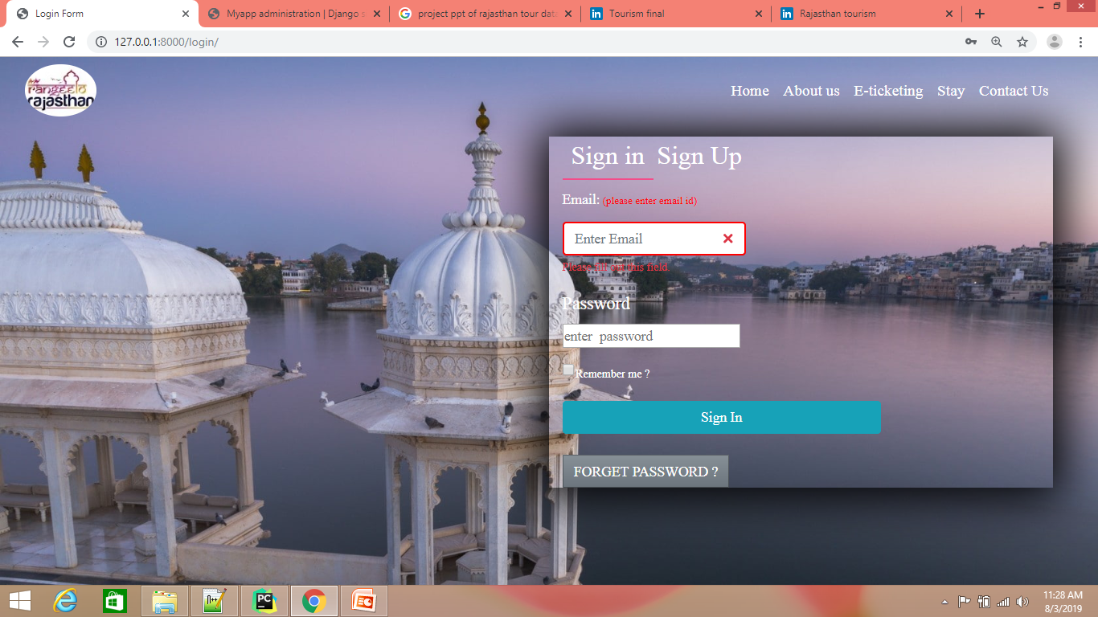
Login

Slide 10
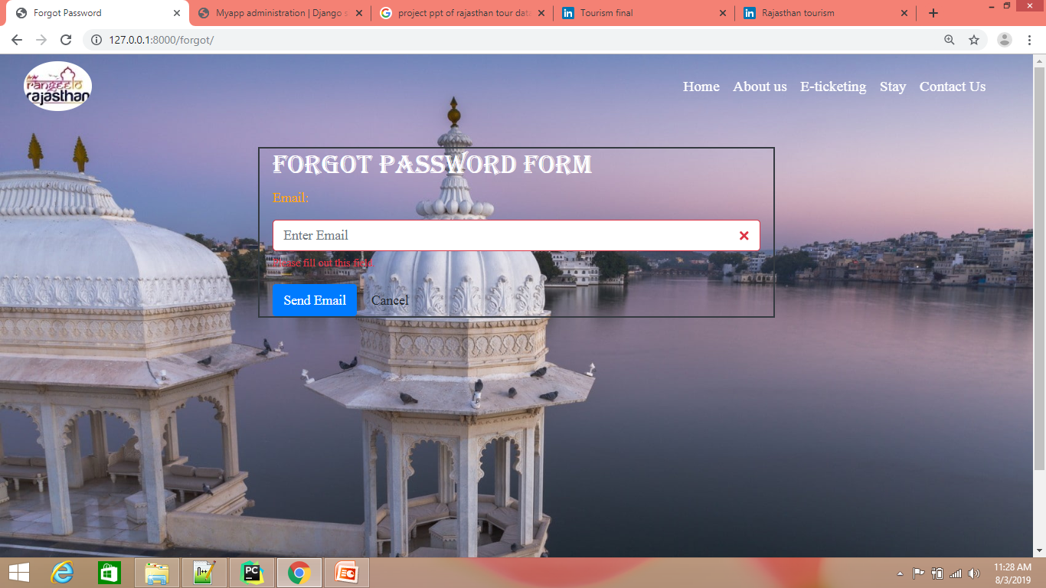
Forgot Password

Slide 11
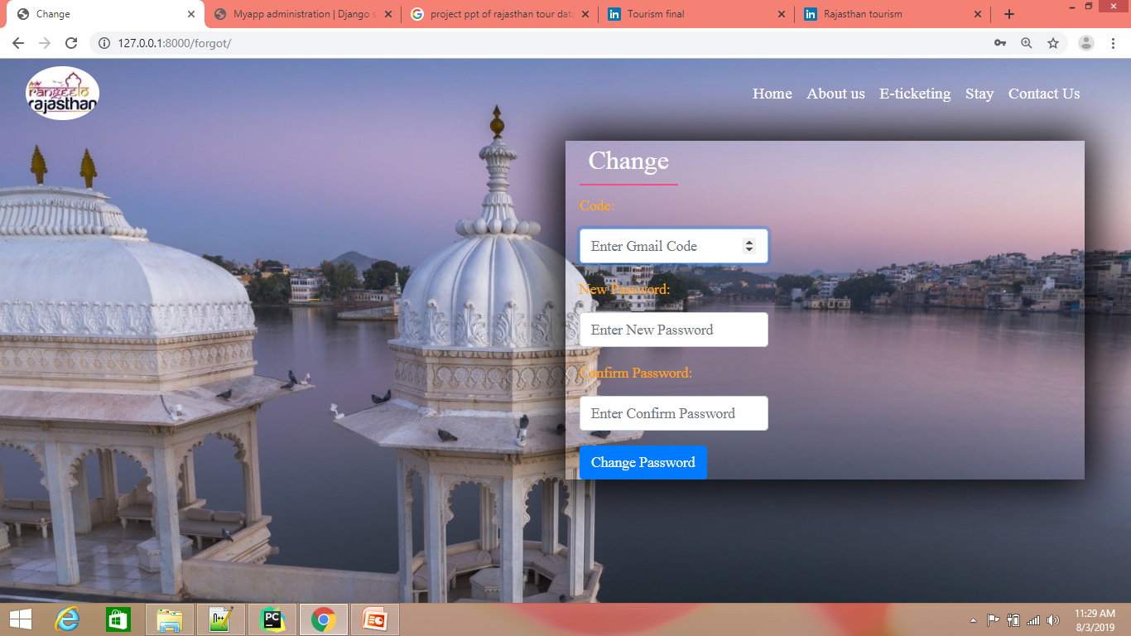
G-mail Code

Slide 12
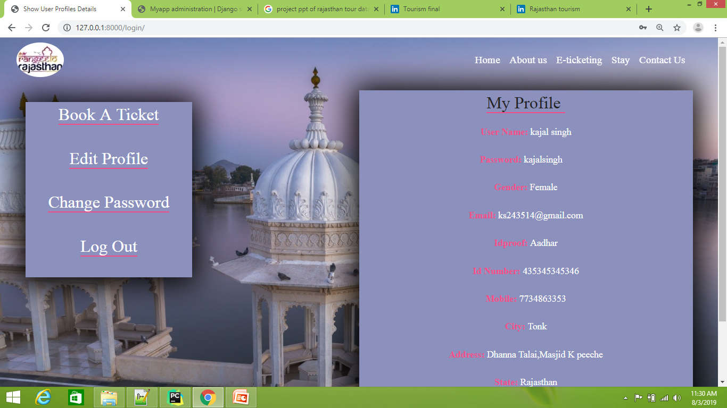
My Profile

Slide 13
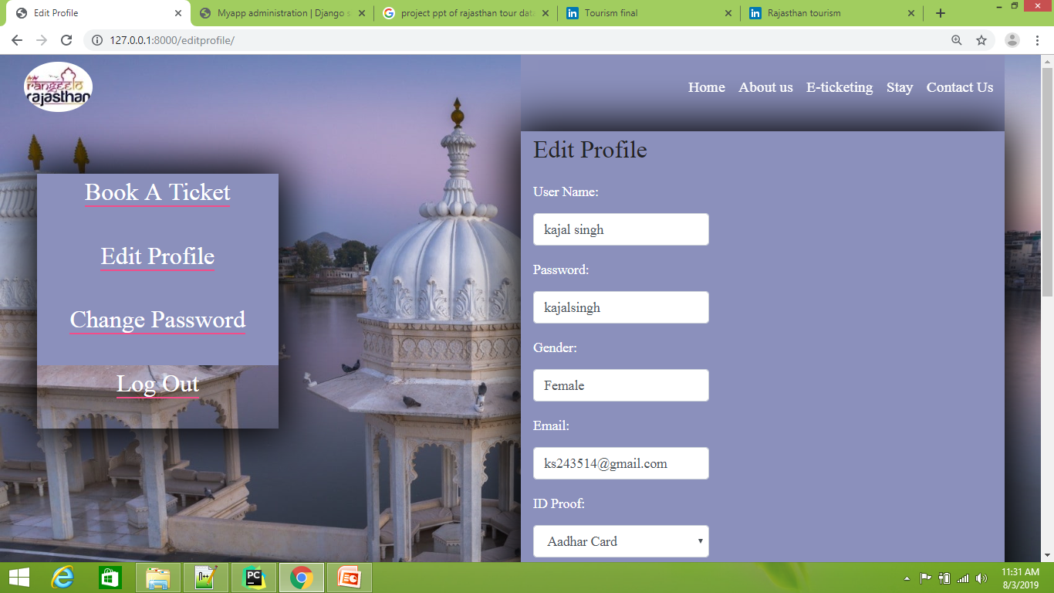
Edit Profile

Slide 14
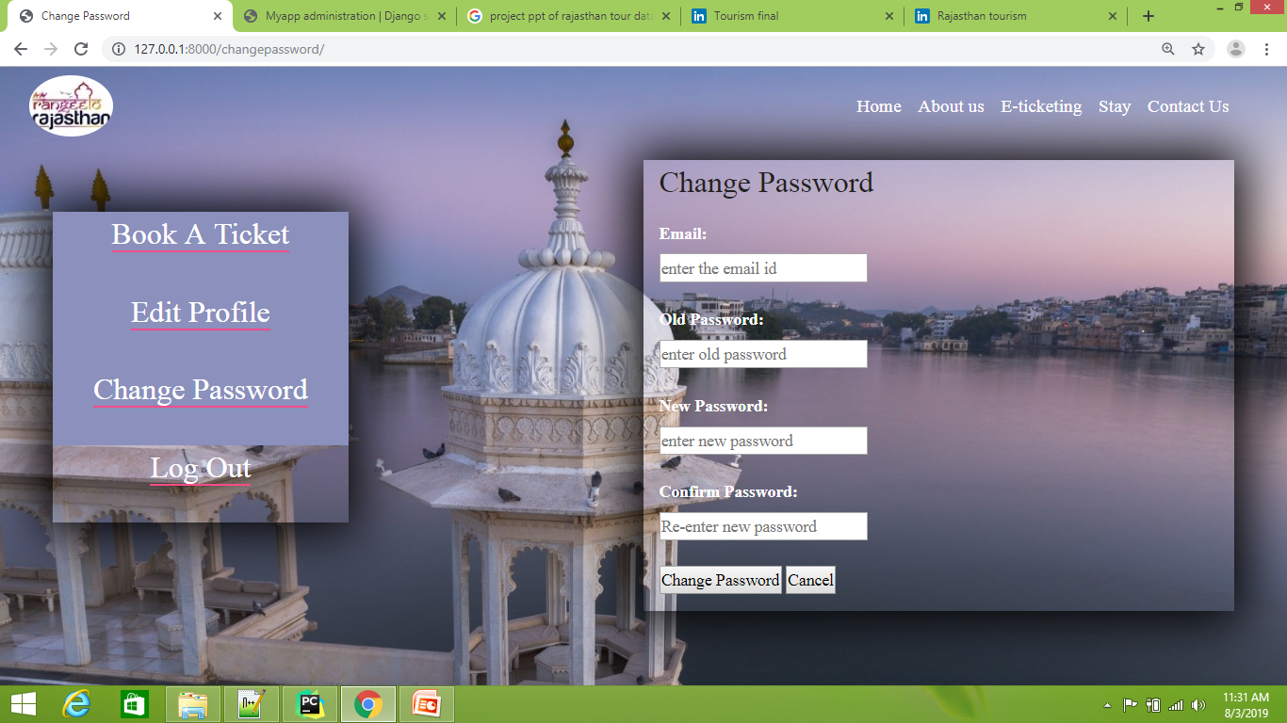
Change Password

Slide 15
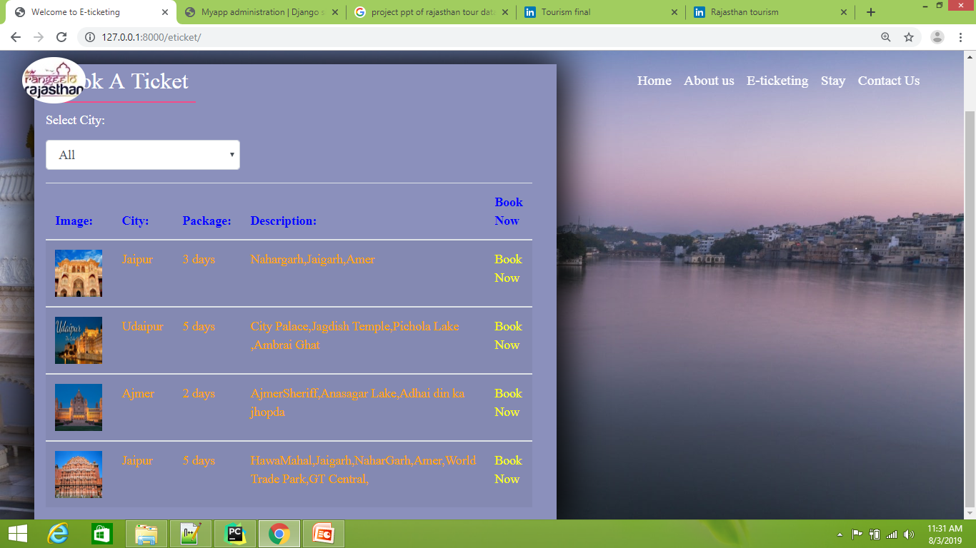
Tour Packages

Slide 16
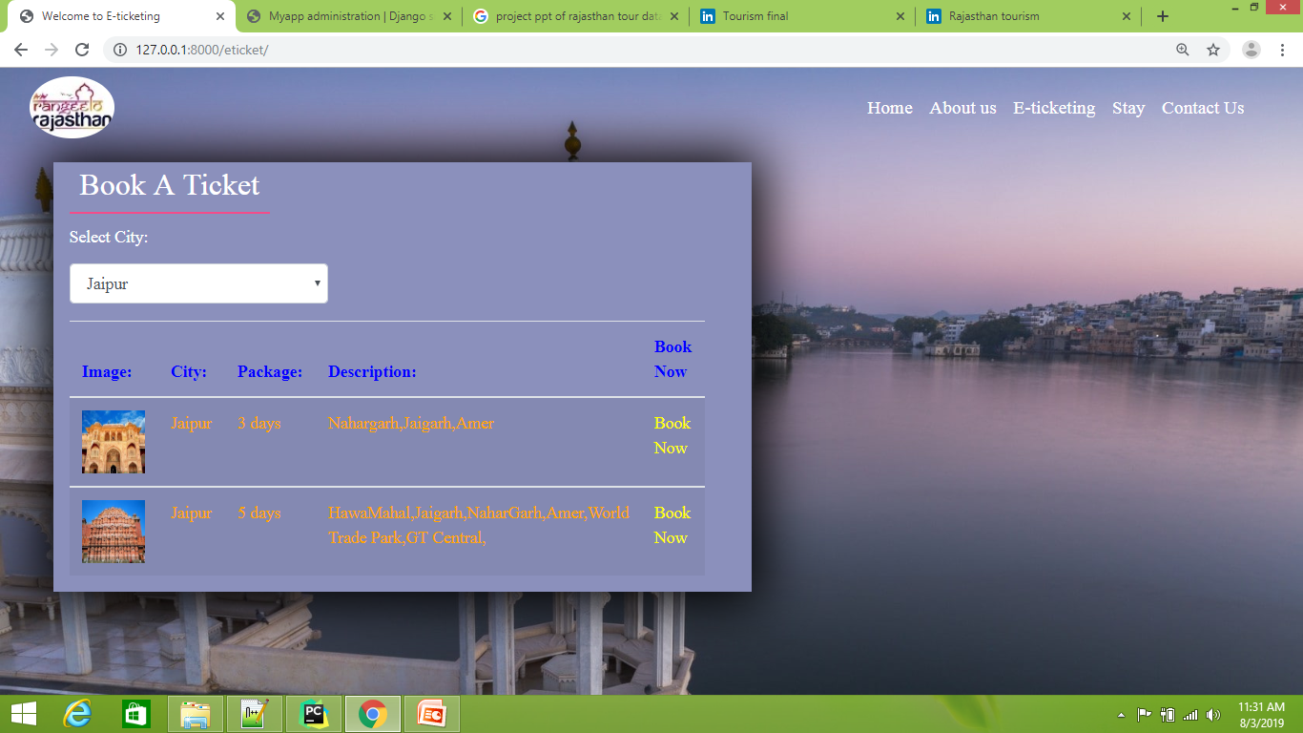
Selected Tour Package

Slide 17
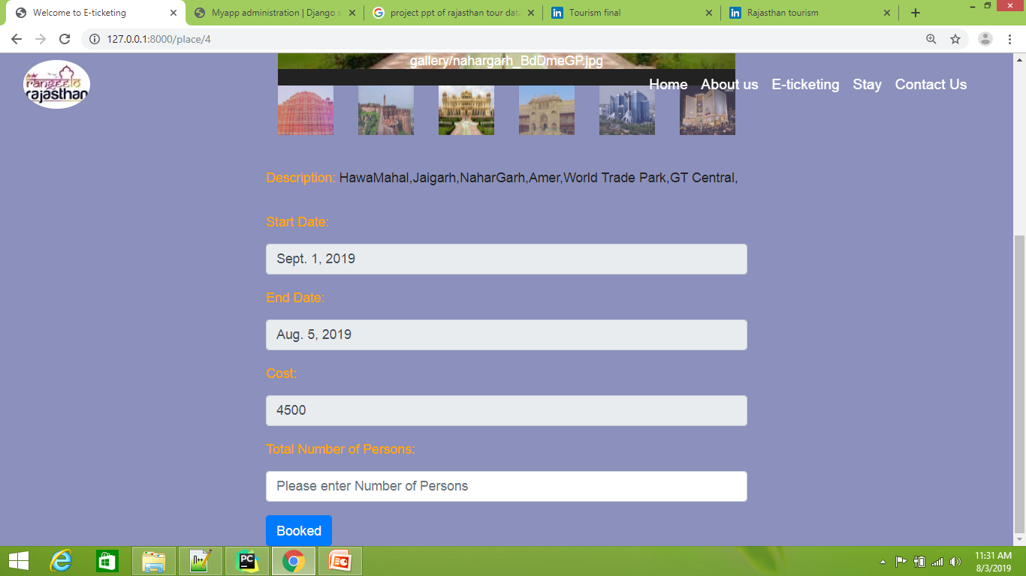
Tour Details

Slide 18
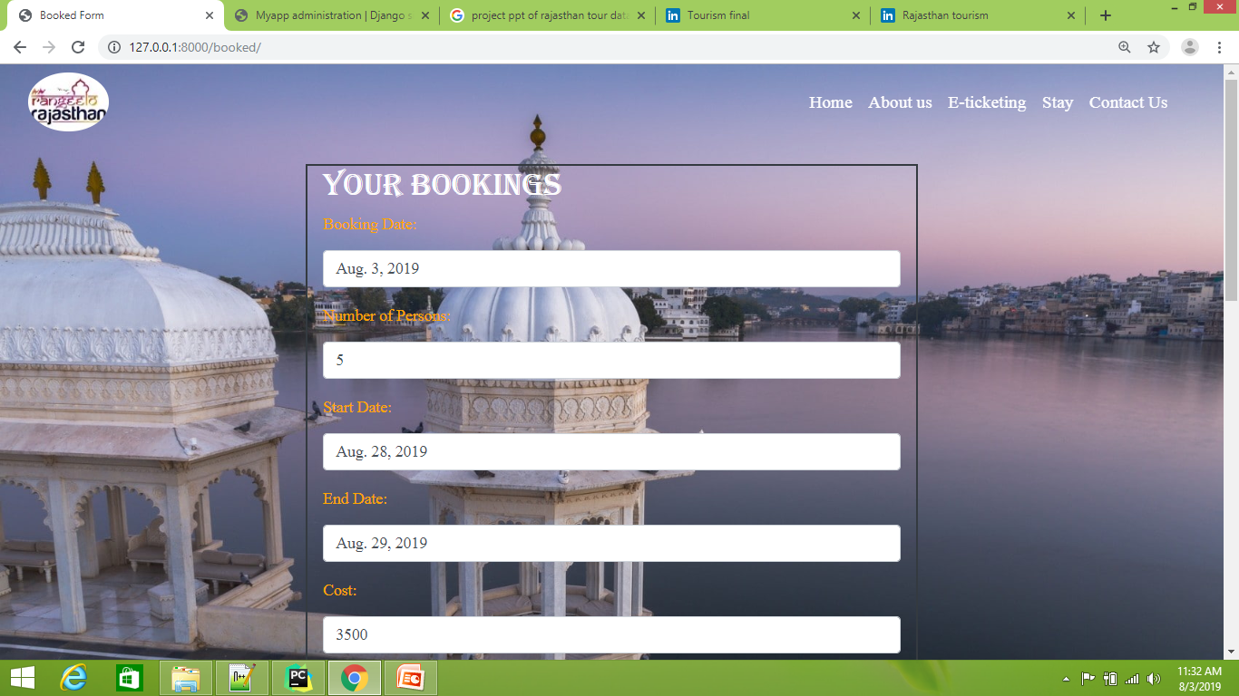
User Booking Details

Slide 19
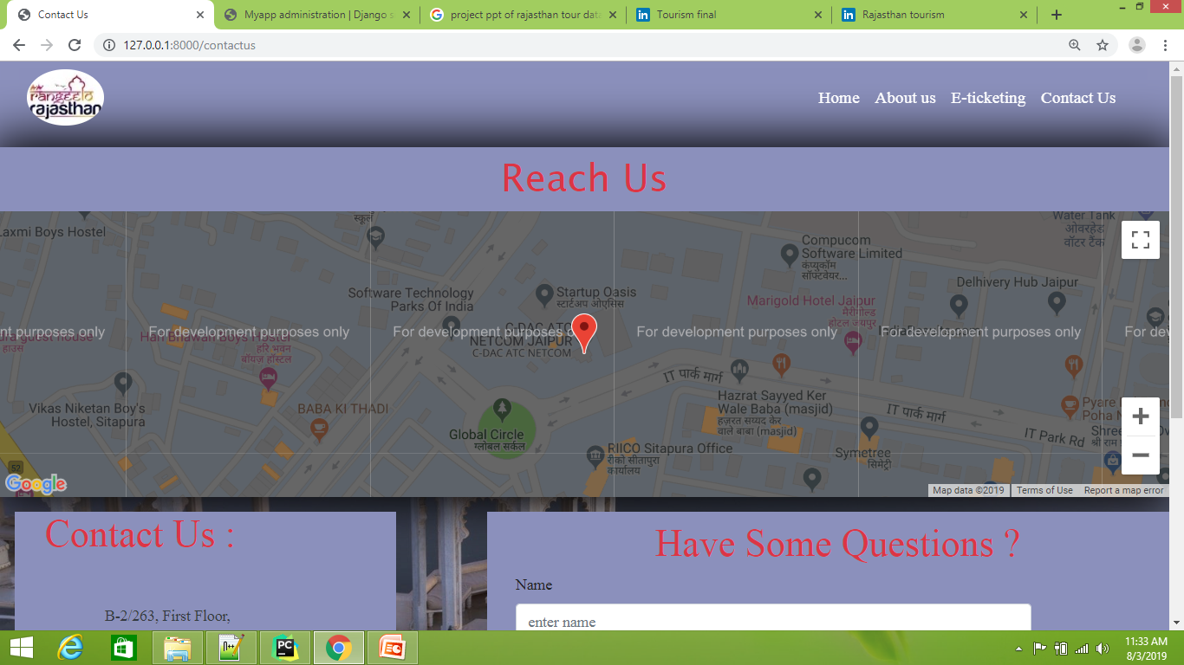
Reach Us

Slide 20
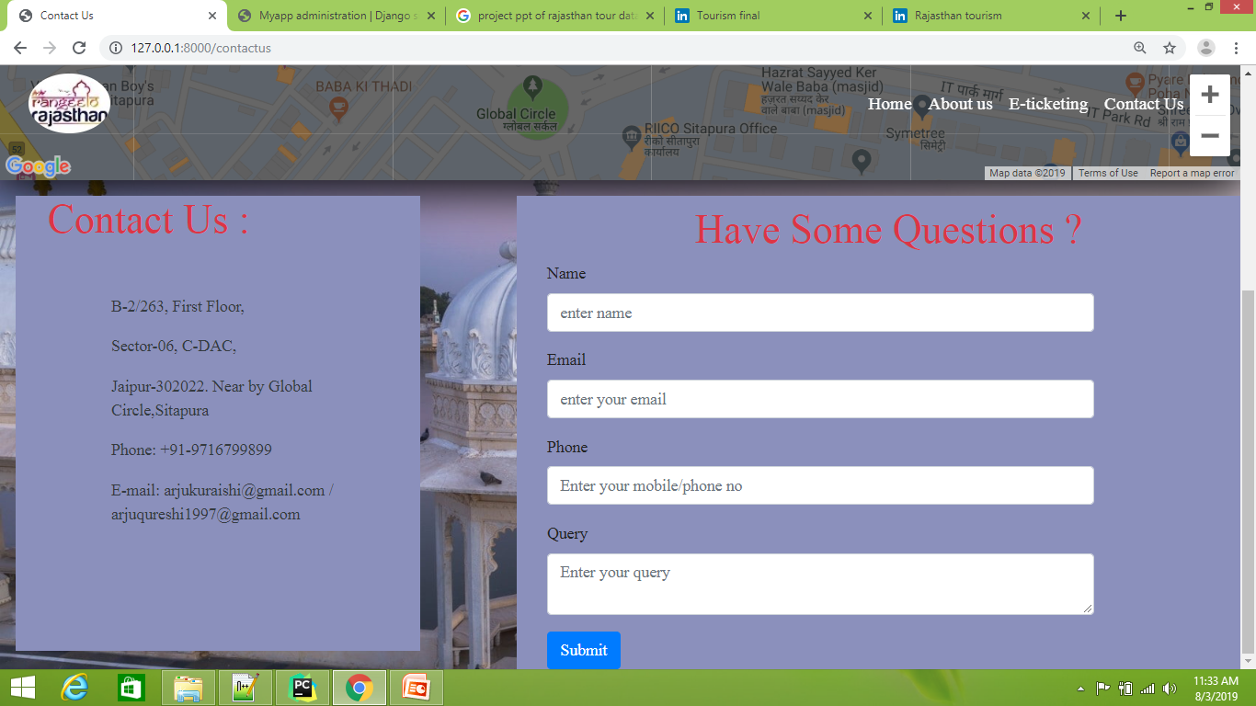
Contact Us & Query

Slide 21
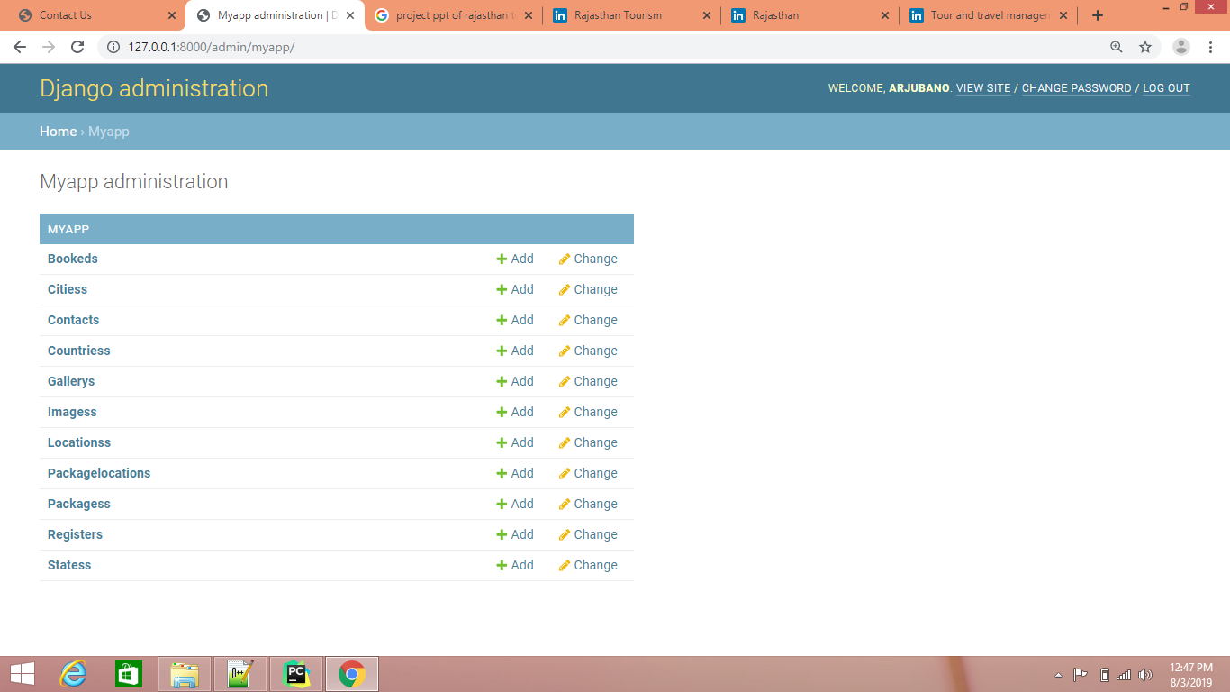
Database (Dynamic Fields)

Slide 22
Conclusion
The main conclusion of Online Rajasthan Tourism is used by admin to manage the states and cities which he/she able to handle and can take record of various bookings, can upload easily the new scene of Rajasthan Tour and its places.

Slide 23

THANK YOU
Presented By
Arju Bano & Shikha Tiwari

